Slide 1

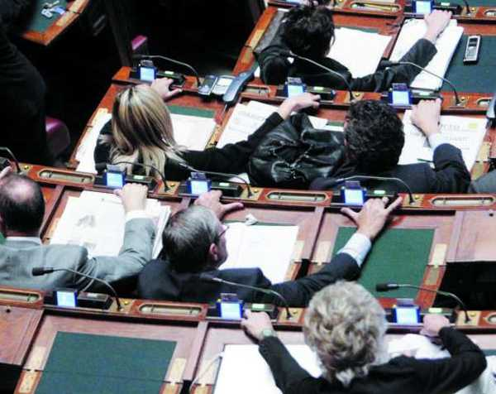
Professional and Ethical Standards for Parliamentarians in OSCE Region
“Democracy, with its representative and pluralistic character, entails accountability to the electorate, the obligation of public authorities to comply with the law and justice administered impartially”.
(Paris Document, 1990)
“OSCE participating States pledge to promote good government practices and public integrity”.
(Istanbul Document, 1999)
“The OSCE Parliamentary Assembly encourages the parliaments of the OSCE participating States to develop and publish rigorous standards of ethics and official conduct for parliamentarians and their staff”.
(Brussels Declaration, 2006)

Slide 2
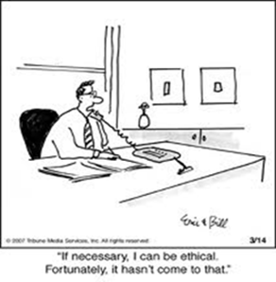
Perception of Corruption in
National Parliaments in the OSCE Region
Parliaments in the OSCE region are perceived as the second most corrupt institution in a majority of OSCE participating States.
The graph represents an average from 40 out of 57 OSCE participating States.
- % of people reporting the sector/institution being corrupt or extremely corrupt
(source: 2013 Transparency International Global Corruption Index)

Slide 3
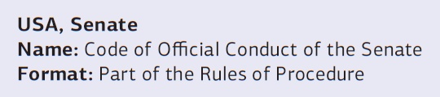
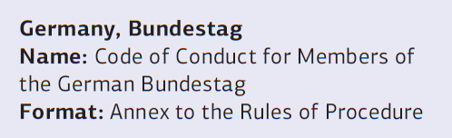
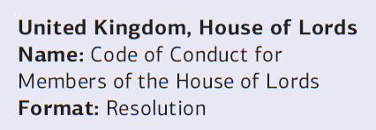
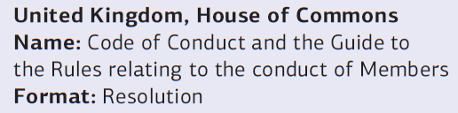

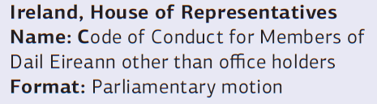

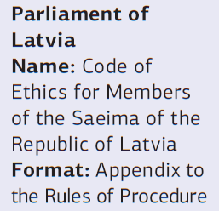
Codes of Conduct in the OSCE
The European Parliament introduced codes of conduct in 2011
Additionally seven participating States are currently engaged in developing codes of conduct for national Parliaments

Slide 4
The effective
impact of codes of conduct
‘Obviously the innovation does not lie in the standards themselves. What is new is the fact that
rules of conduct have now been codified, thus providing a further tool for public scrutiny and
enhancing accountability’.
(From the Maltese Parliament Code of Ethics)
‘With such a code I have the opportunity to weight what I do, or weight what the public and
external bodies expect of those who represent them in parliament. With such a code, ordinary
people also have the opportunity to weight my behavior in relation to the code of conduct’.
(Kevin Barron MP, UK)
Terms of reference for MPs and general public → All official rules are explained in one place; source of guidance for MPs, media, and voters.
Improved accountability → The code sets clear standards against which the public and the media can judge MPs, while protecting their private lives from scrutiny.
Prevent corruption → The code help to prevent abuse of office and other forms of corruption setting out clear rules, monitoring their implementation, and punishing transgressions.

Slide 5

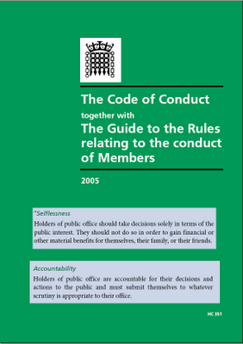
Codes: How do they work?
Establishing common values
Setting rules
Encouraging monitoring
Sanctioning violations
Codes work best when…
There is underlying consensus on the rules
Peers monitor one another
Breaches are punished by proportionate sanctions and by peers

Slide 6
Which aspects to be regulated?
Interests and assets
Attitudes towards
Compatibility of public
and private roles vary greatly across the OSCE region.
Two approaches are visible:
Ban MPs from certain roles;
Require MPs to disclose and declare their interests.
To reveal potential conflicts of interest, two main tools are used:
Register of Interests;
Asset declaration.
Expenses and allowances
Conduct in/outside the chamber
Post-parliamentary employment
Dress and language codes

Slide 7
Assets and Interests
One of the key objective is to avoid or limit conflicts of interest.
“A conflict between the public duties and private interests of a public official, in which the public official has private-capacity interests which could improperly influence the performance of their official duties and responsibilities”.
Three main approaches:
MPs are banned from taking on certain roles, through laws on incompatibility or conflict of interest.
Allow MPs to hold other interests but require them to disclose the details in ad hoc and publicly available Registers of Interests → Key role of media/civil society
Intermediate approach, prohibiting some interests but allowing others, as long as they are disclosed.
Tools for declaring and disclosing MPs interests:
Register of Interests → information is centrally collected and frequently updated
Assets declaration → give details of wealth when they join and leave parliament.

Slide 8
Range of possible interests of MPs

Slide 9

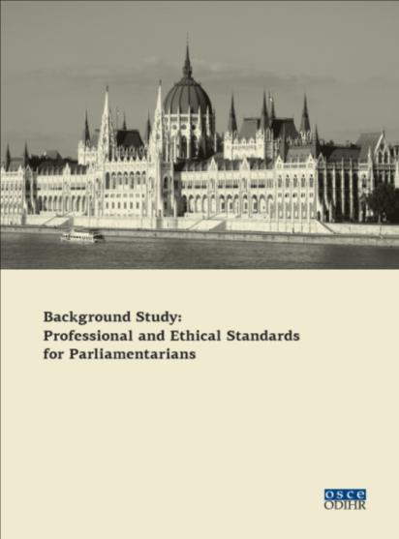
ODIHR’s work on Parliamentary Ethics
The ODIHR Background Study: Professional and Ethical Standards for Parliamentarians - comprehensive publication analysing how to set professional and ethical standards for Members of Parliament and regulate their conduct.
Upon request ODIHR supports the development of codes of conduct in a number of participating States. (e.g. Estonia, Georgia, Sweden and Ukraine)
ODIHR works on raising awareness among participating States on parliamentary ethical standards by promoting the Study and the expertise of ODIHR in this field. (e.g. Albania, Poland and Austria)
Regional Study tours on Parliamentary Ethics in 2013 and 2014 for over 40 MPs from 14 OSCE participating States.
ODIHR closely works with Field Operations to support participating States in developing codes of conduct.

Slide 10
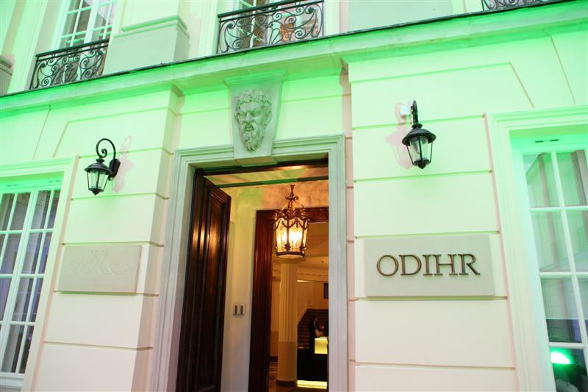
Thank you for your attention!
OSCE/ODIHR
Office for Democratic Institutions and
Human Rights
ul. Miodowa 10
00-251 Warsaw
Poland
http://www.osce.org/odihr

